Slide 1

Exploratory Data Analysis and Modelling Proposal
Persistency of a drug
Team : OpenML
Members : - Juan Carlos
- Laith Adi
- Gerson Orihuela
- Walquer Valles
Date : 15-May-2021

Slide 2
Agenda
Problem Statement
Approach
EDA
EDA Summary
Recommendations

Slide 3
Business problem
ABC Pharma contacted us to carry out an analysis in order to have a deeper understanding on the factors impacting the persistence of their drug. The aim is to know if a patient, based on his/her information, will follow the prescription of the physician and continue taking the drug for all the treatment time.

Slide 4
Approach
1 file was provided: Healthcare_dataset.xlsx
The file contained information of 3, 424 patients. For each patient it has demographic information, clinical records, others diseases as risk factor information and also about their physicians specialty.
The variables provided have been treated individually among the four members of the team.
The EDA has been carried out following the same arrangement, but taking into account the whole dataset, so that potential insights have been drawn from the analysis.
Four model proposals have been developed.

Slide 5
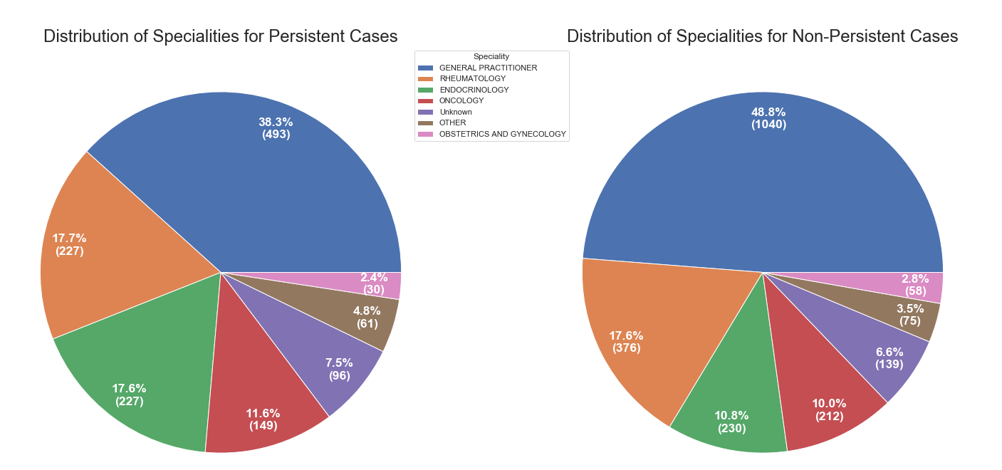
Clinical Factors
Does the speciality of the person who prescribed the drug have any effect on the persistent rate?
We see that both pie charts are pretty similar in distribution of frequency for each speciality. Thus, we can rule out the possibly that one of the factors that the drug is persistent or not is the speciality that perscribed the drug in the first place.

Slide 6




Clinical Factors
Does 'Ntm_Specialist_Flag' and 'Ntm_Speciality_Bucket' variables have useful information for the classification task?
It seems Rheum flag in Ntm_Speciality_Bucket have some useful information.
]What about 'Gluco_Record_Prior_Ntm', 'Gluco_Record_During_Rx'?
Gluco_Record_During_Rx seems to be more useful than Gluco_Record_Prior_Ntm to predict the target

Slide 7
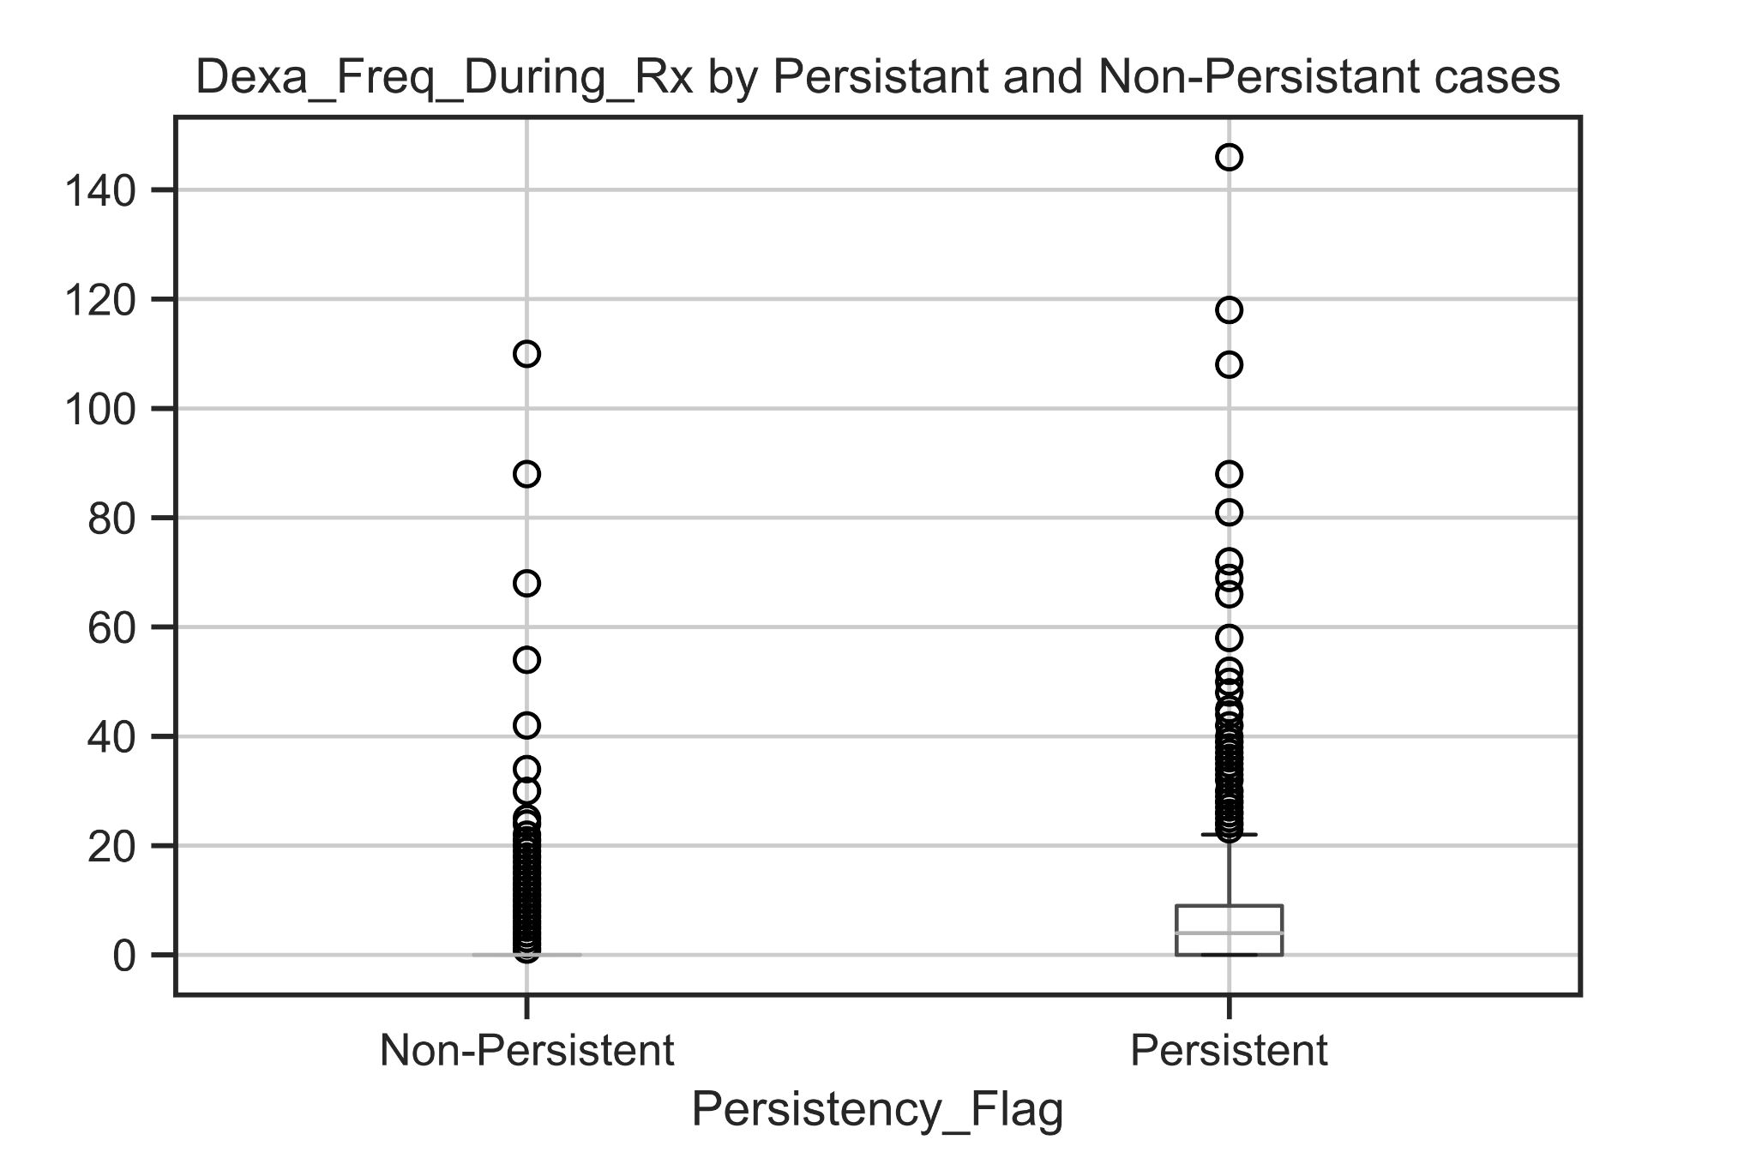

Clinical Factors
The distribution of Dexa_Freq_During_Rx numbers seems to be higher in the Persistent patients
Variables that are recorded during the treatment have more useful information for the classfication than others. It can be checked with the percentajes shown by Dexa_During_Rx variable.

Slide 8
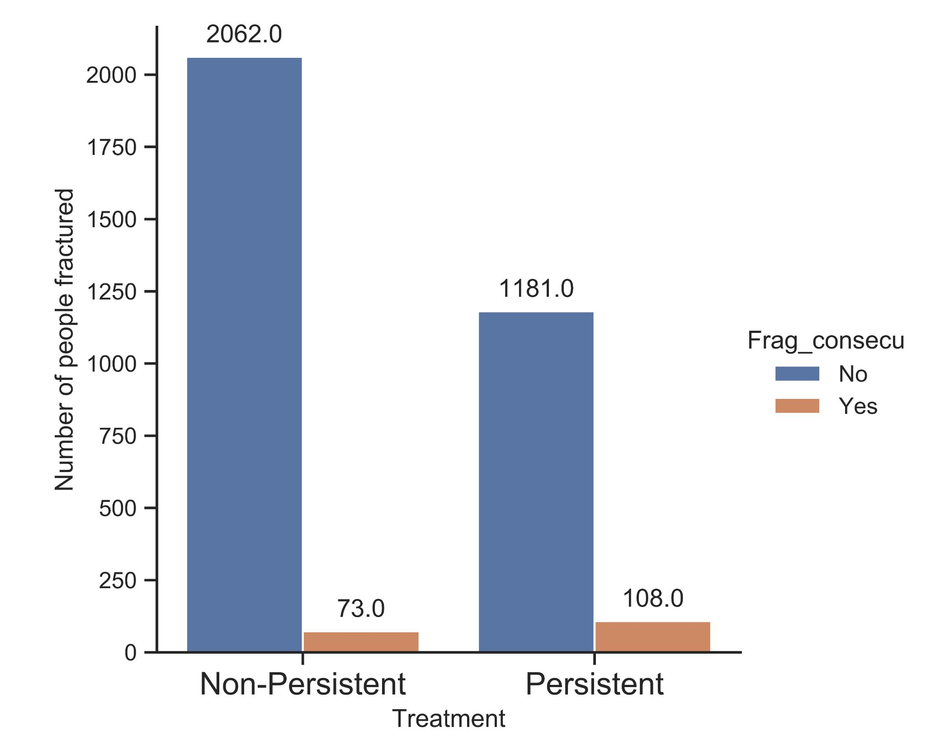
Fracture variable
Of the total number of patients, 8.38% of people were affected by the treatment, weakening their bones
In the graph, 1289 people were persistent with their treatment, and of this 1289 only 108 people were affected weakening their bones.
The count of people affected by the treatment is small and we can speculate that the treatment not affected considerably to the bones of the patients.

Slide 9
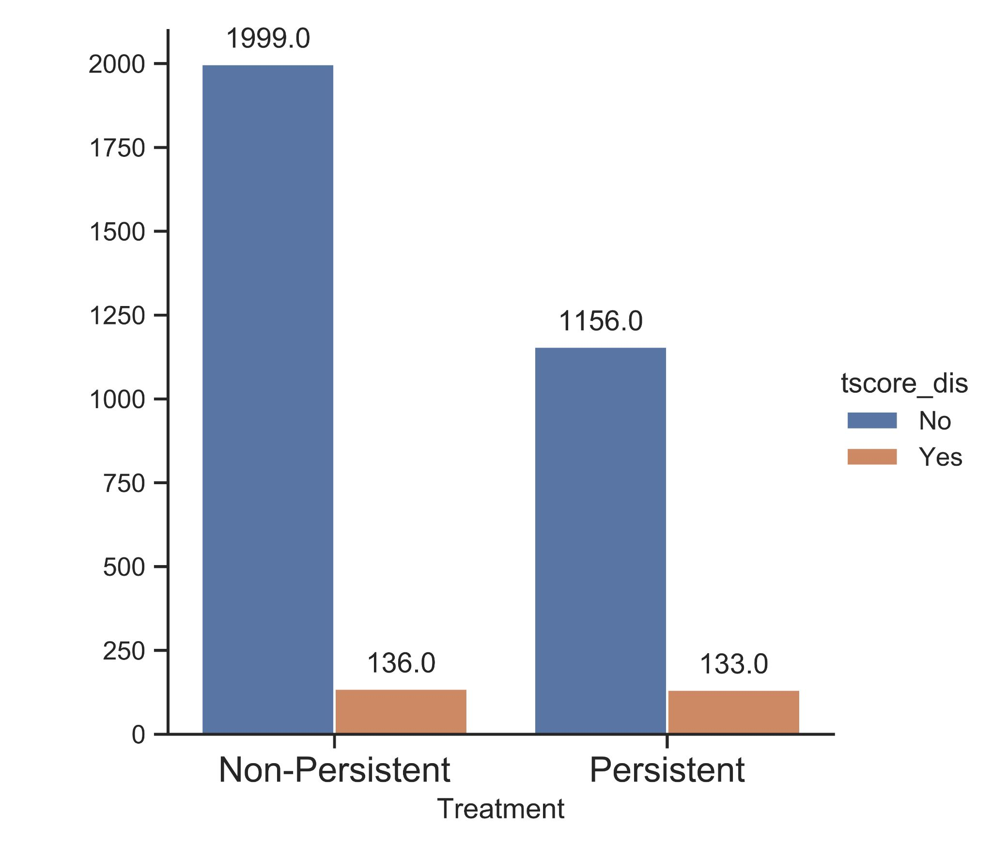
T-score variable
There is 10.31% of people with treatment who had a decrease in the t-score
Then there is 90% approximately of people who maintained or improved their t-score.
In conclusion the treatment is improving the t-score of the patients.

Slide 10
Risk, comorbidity and concomitant factors
Most of the patients already hold comorbidity factors, while holding risk factors is less common.
Some highlights:
The main comorbidity factor is related to lipoproteins and metabolism (cholesterol).
The main risk factor is deficiency in vitamin D.
More than one third has been found to have taken narcotics.
99 % of our sample hold at least one risk, comorbidity and/or concomitant factor.

Slide 11
Risk, comorbidity and concomitant factors
There are some significant differences between genders:
Women seem to be more affected by vitamin D deficiencies.
More than twice as many women as men have passed as screening for malignant neoplasms.
Four times as many men as women suffer from Hypogonadism (untreated).

Slide 12
Risk, comorbidity and concomitant factors
As expected, patients older than 65 are affected by the mentioned factors in a higher proportion.
There are some risks and other factors that seem to be significantly higher in South and West regions. It might be interesting to find out about socioeconomic factors aside.
There seem to be some remarkable differences between Asian and other races. They are probably due to cultural factors and other behaviours, like medical reviews on a more regular basis (this is just a hypothesis to be found out).

Slide 13
EDA Summary
The file contained information of 3, 424 patients. For each patient it has demographic information, clinical records, others diseases as risk factor information and also about their physicians specialty.
There are some significant differences between genders (vitamin D deficiencies, screening for malignant neoplasms, Hypogonadism).
Most of the patients already hold comorbidity factors, while holding risk factors is less common.
Patients older than 65 are affected by the mentioned factors in a higher proportion.
There seem to be some remarkable differences between Asian and other races.
Variables that are recorded during the treatment like Dexa_Freq_During_Rx, Dexa_During_Rx and Gluco_Record_During_Rx have more useful information for the classification than others.

Slide 14
Model proposals (technical review)
Support Vector Machines algorithm to classify the persistence of patients (1 for positives and -1 for negatives). The whole dataset is composed of 3424 feature vectors of 83 dimensions, plus the target variable. A linear kernel has been used, obtaining an accuracy of 83.5 % over testing data (25 % out of the whole dataset).
Random Forest algorithm for classification (1 for positives and 0 for negatives). The algorithm has 1000 estimators, max_depth of 10, obtaining an accuracy of 81% and AUC of 89% over testing data.
Decision Tree algorithm (0 for Persistent and 1 for Non-persistent). The input is composed by 64 features with 3424 observations. The tree got best predictions with max depth of 1, obtaining an accuracy of 76% on test data.
Logistic Regression algorithm for binary classification. The labels are the following: 0 for Non-Persistent and 1 for Persistent. Using GridSearchCV for optimization, the LR model uses 204 columns (after one-hot-encoding) to train. The f1_score obtain is 82%.

Slide 15
Thank You

